Slide 1

Scaling Betsson Journey of the monolith Roger Johansson
Akka.NET Founder Twitter: @rogeralsing
Github: rogeralsing
Mail: roger.johansson@betsson.com
Github.com/rogeralsing/presentations

Slide 2






Who are we?
Multi brand gaming and betting company
Tech stack is mainly .NET

Slide 3
What to expect from this talk
A bit of history on where we came from in terms of architecture
Geekery about microservices, service discovery, Docker and .NET Core
I will not talk about Akka.NET
I am under NDA
I am not an Ops guy

Slide 4
The Past

Slide 5
One Brand, One System
Bets10
The Monolith

Slide 6
We acquired more brands
Betsafe
Bets10
NordicBet
?
The Monolith
?

Slide 7
Scaling the monolith
A monolithic application puts all its
functionality into a single process…
…and scales by replicating the
monolith on multiple servers
-Martin Fowler, James Lewis

Slide 8
Scaling by Instance
Instance 1
Instance 2
Instance 3
Brand A, B
Brand C
Brand D

Slide 9
Introducing SOA
Still pretty darn big services
Instance 1
Instance 2
Instance 3
Customer
Customer
Customer
Gaming
Gaming
Gaming
Campaigns
Campaigns
Campaigns
…
…
…

Slide 10
Problems?

Slide 11
Point to point communication
Single Message Producer
Single Message Consumer
No Redundancy
Doesn’t Scale

Slide 12


Shared Servers, Noisy Neighbours
Instance
Customer
Gaming
Campaigns
…

Slide 13

Single point of failure…
Instance
Customer
Gaming
Campaigns
…

Slide 14
…Same issue with deployment
Down during deployment
Instance
Customer
Gaming
Campaigns
…

Slide 15
Problems!
Scalability, Elasticity
Isolation
Availability
Deployment

Slide 16
The Current

Slide 17
Microservices

Slide 18
Scaling Microservices
A microservice architecture puts
each element of functionality into a
separate service…
…and scales by distributing these services
across servers, replicating as needed
-Martin Fowler, James Lewis

Slide 19
Scaling Microservices
Where are you guys!?
I’m over here!

Slide 20
Service Discovery
Service Registry
Publish ”I am A”
Publish ”I am B”
Service A
Service B

Slide 21
Service Discovery
Service Registry
Lookup ”Where is B?”
Service A
Service B
Call

Slide 22
Service Discovery
Service A
Service B
Service A
Service Registry
Service B
Service A
Service B

Slide 23
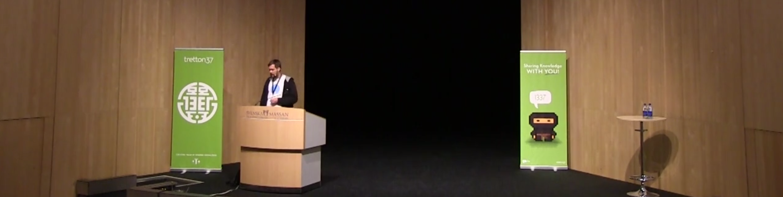
Leetspeak 2014, Niklas Gustavsson/Spotify
Service Discovery using DNS

Slide 24

Consul
λ Consul agent -server -bootstrap

Slide 25
Asp.NET Core

Slide 26

Microphone
Asp.NET Core Consul

Slide 27
Microphone
Consul
Are you alive?
Publish ”I am A”
Lookup: ”Where is X?”
.NET Service A
Microphone

Slide 28
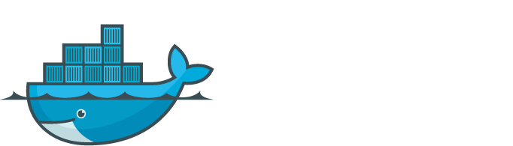

Slide 29
Isolation

Slide 30
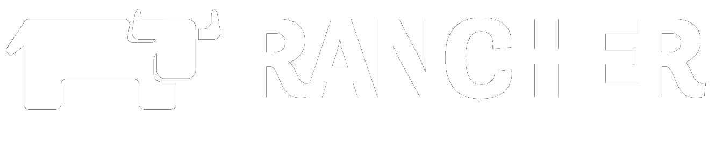

Slide 31
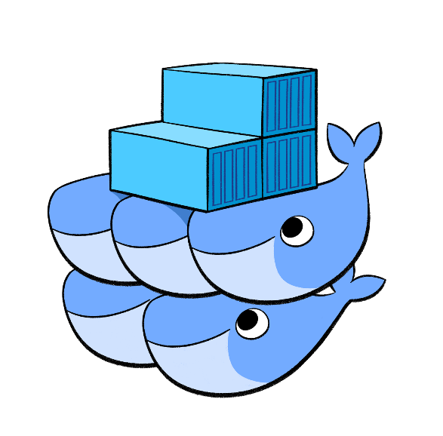


CATTLE

Slide 32
Rancher Demo
Install Consul – Docker Compose
Install Asp.NET Core services
Show Consul UI
Scale Services
Redeploy Services
Integrate with legacy services

Slide 33
THE FUTURE

Slide 34




Selecting a proper tech stack

Slide 35
Why Go or Elixir?
Built for Concurrency
Built for Distributed Systems
A different culture

Slide 36


